Slide 1

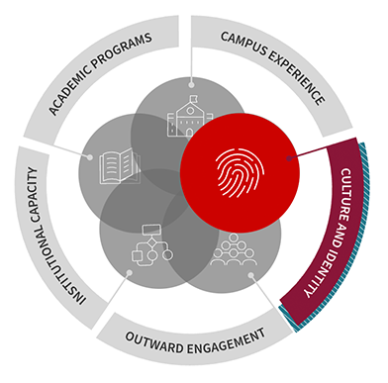
Themes and Ideas that Emerged during
the Diversity, Equity, and Inclusion Mingle
February 11, 2021

Slide 2
We asked participants to…
Identify a story or setting that illustrates a time and/or place where you, personally, experienced a truly inclusive sense of belonging.
Discuss the elements of that experience that created that sense of belonging.

Slide 3
Here are the thoughts that generated discussion …

Slide 4
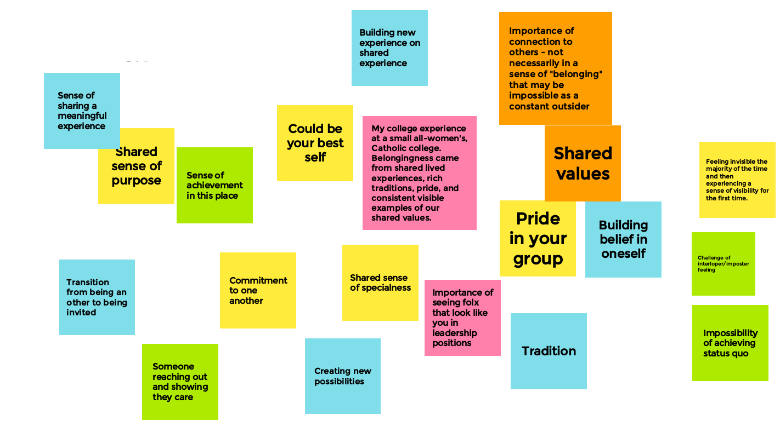

Slide 5
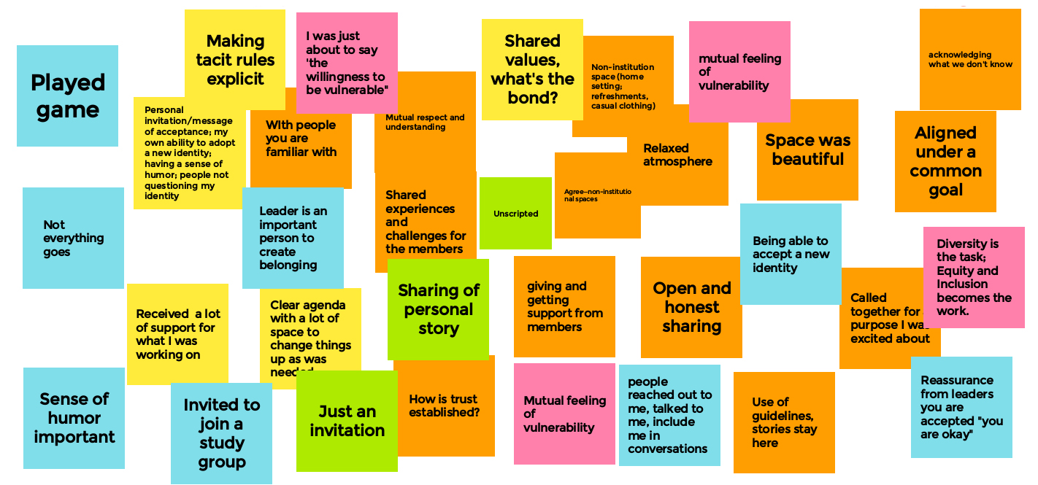

Slide 6
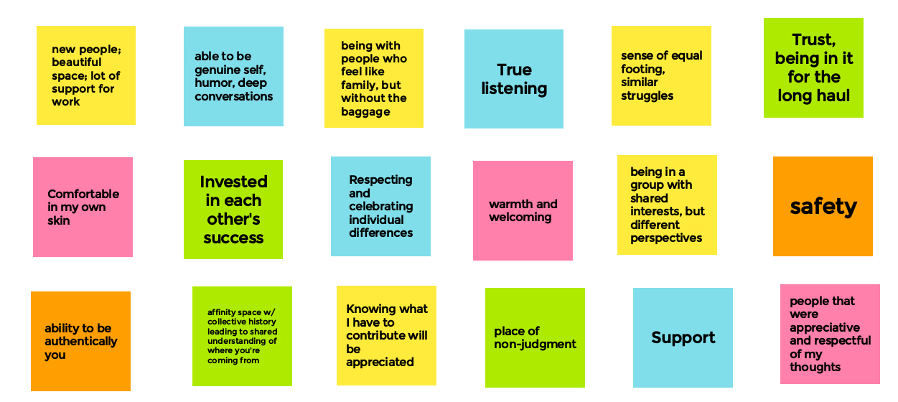

Slide 7
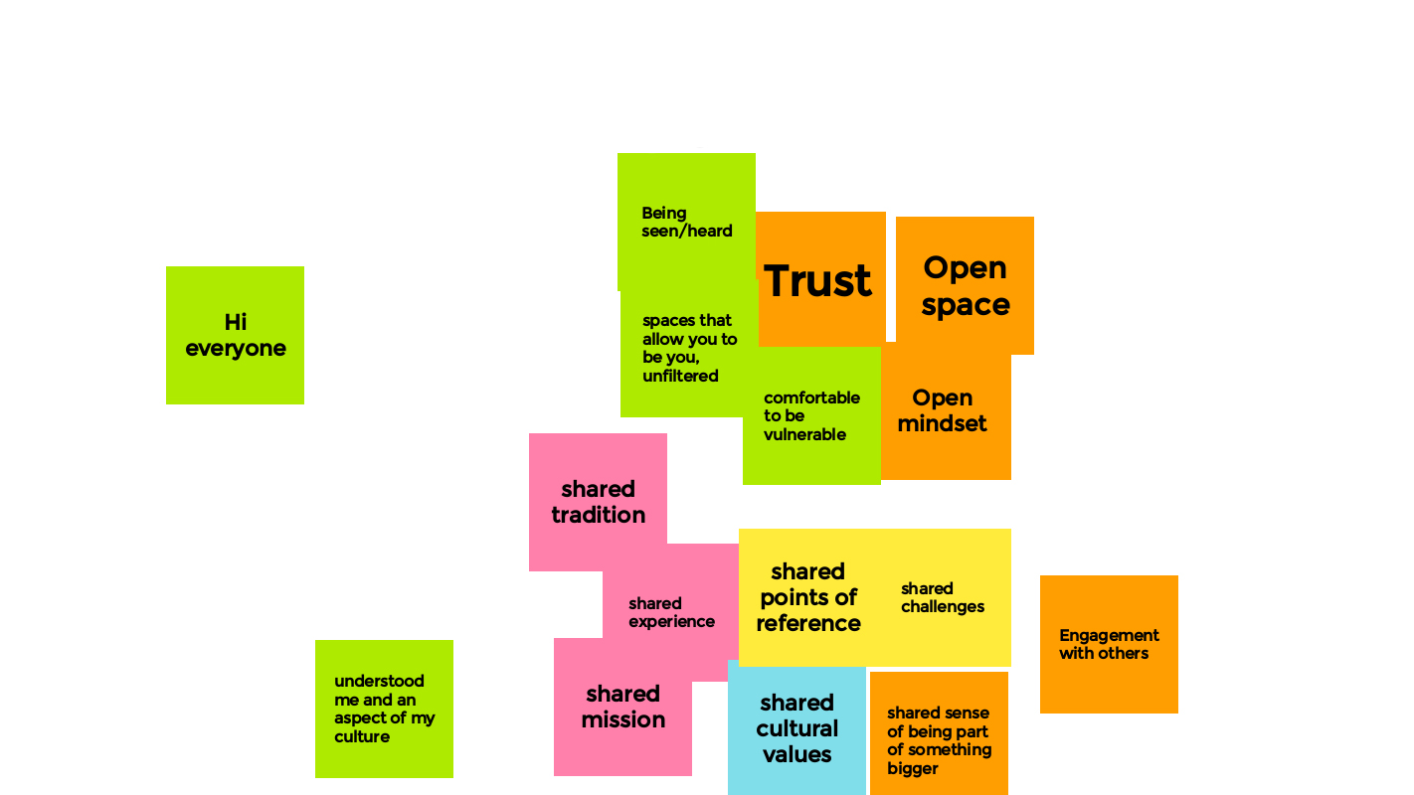

Slide 8
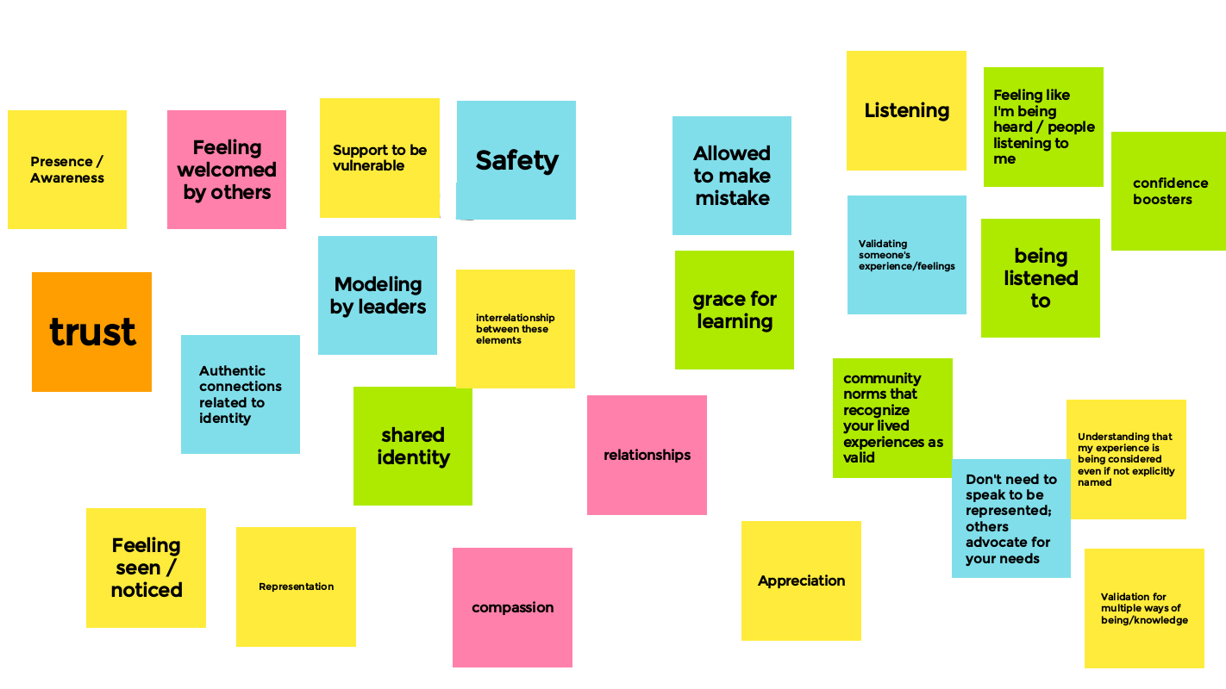

Slide 9
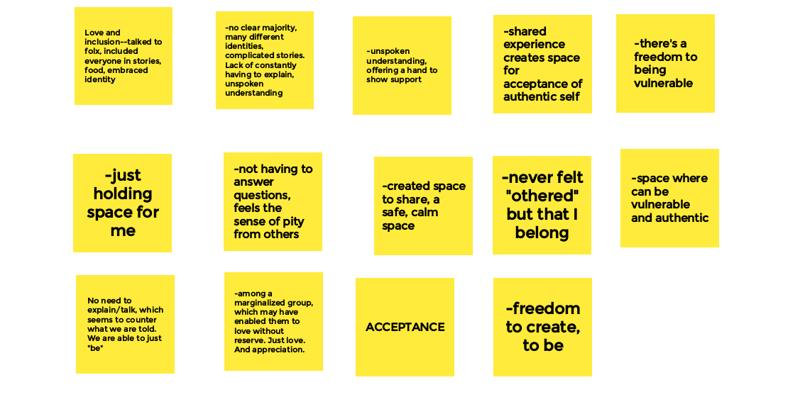

Slide 10
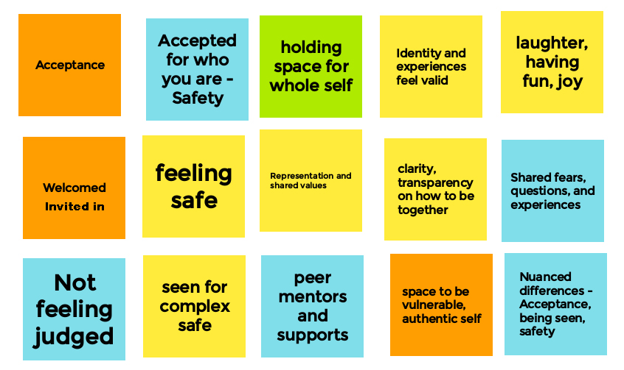

Slide 11
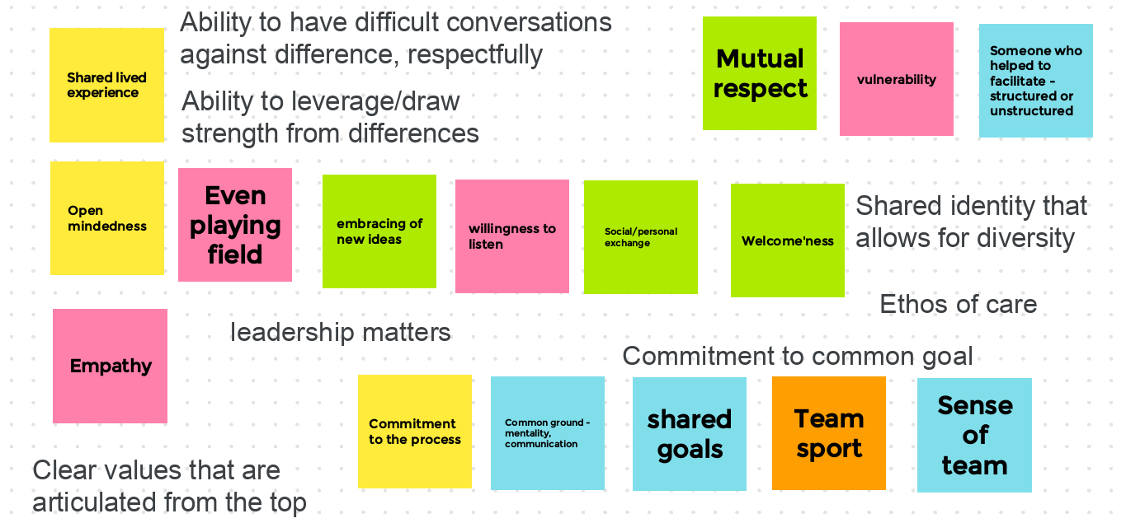

Slide 12
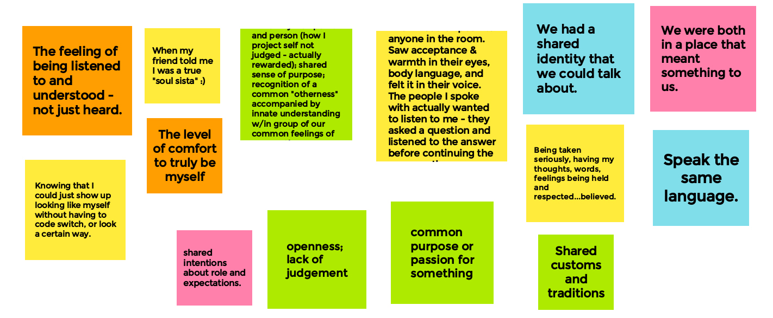

Slide 13
We asked participants:
Who do we have to become as a community for Clark to become more diverse, equitable, inclusive, and just?
What are the conditions that would allow everyone to have a greater sense of belonging?

Slide 14
Here are the answers that generated discussion …

Slide 15
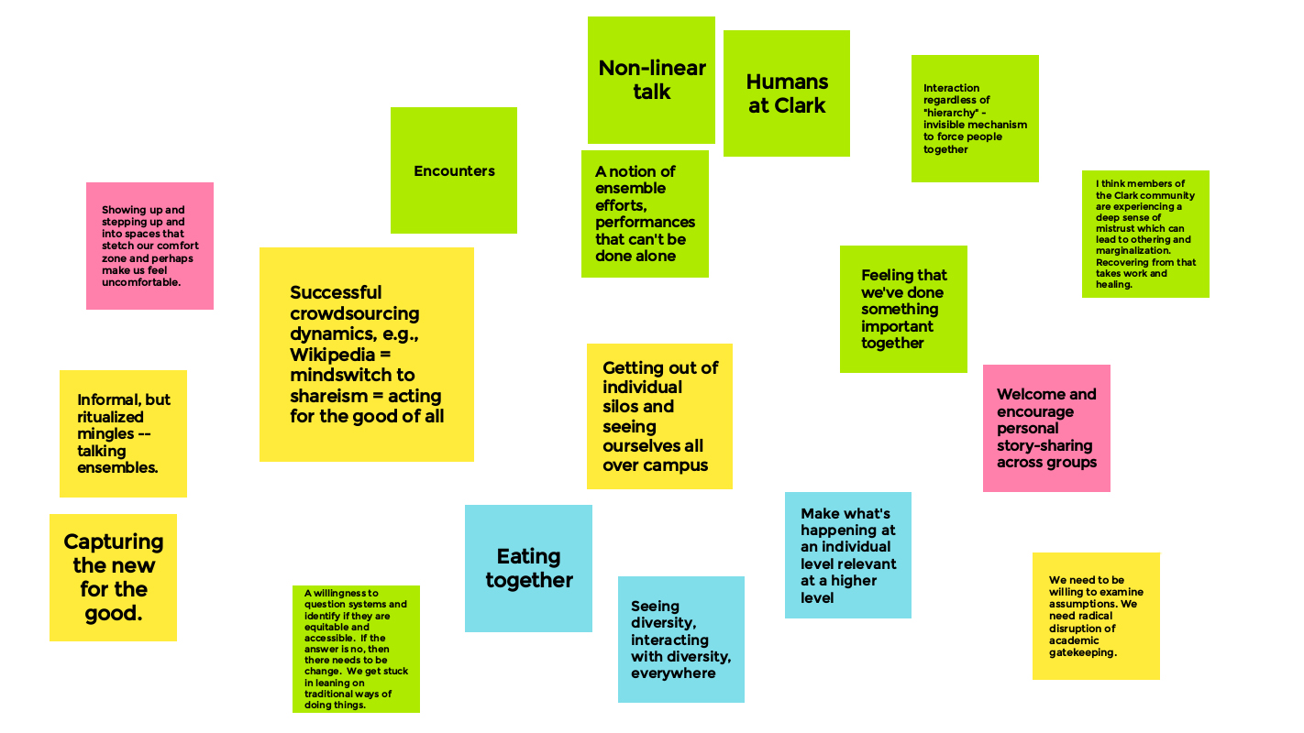

Slide 16
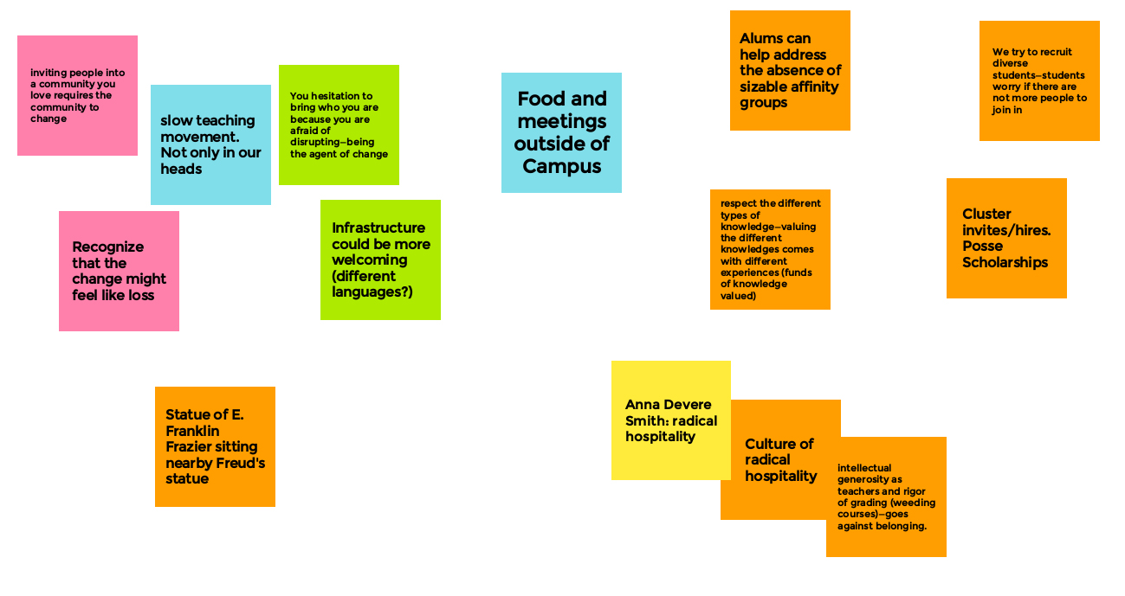

Slide 17
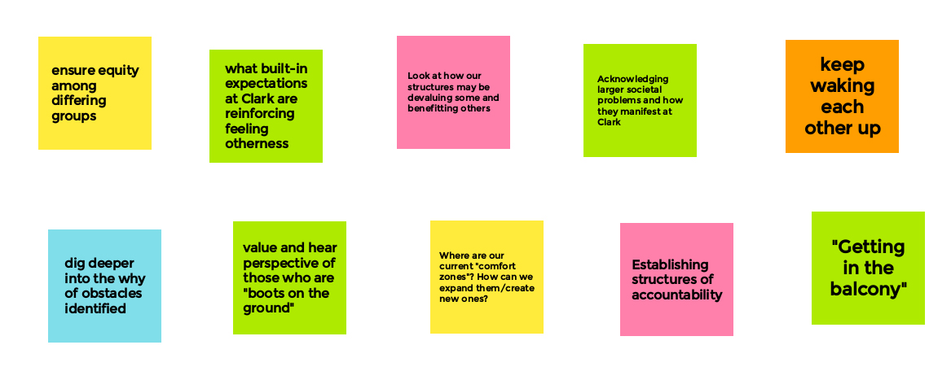

Slide 18
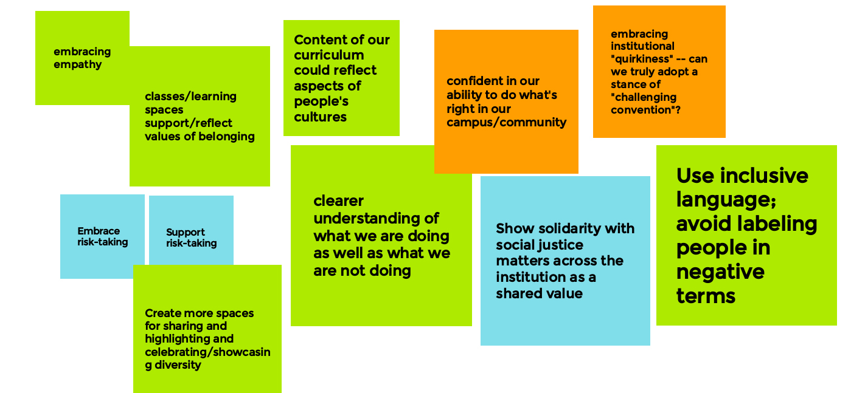

Slide 19
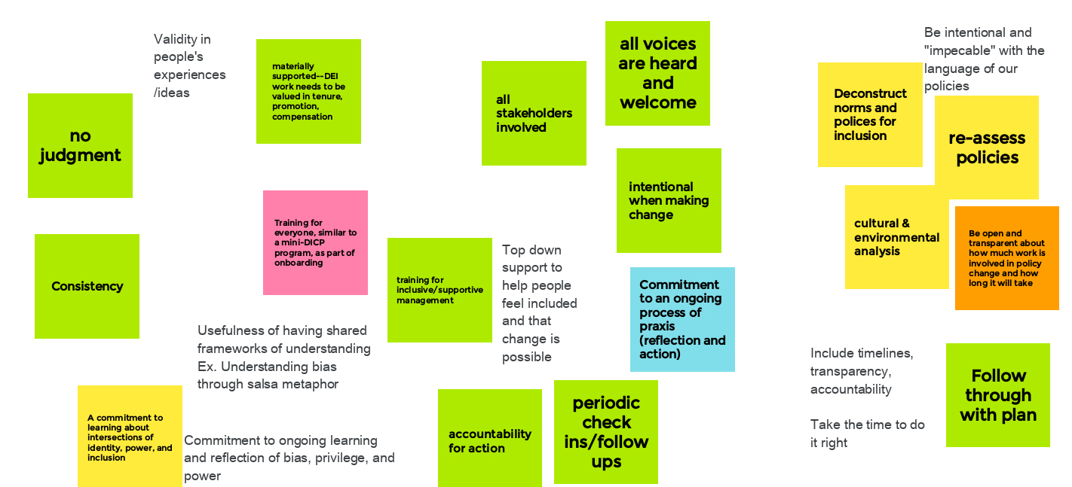

Slide 20
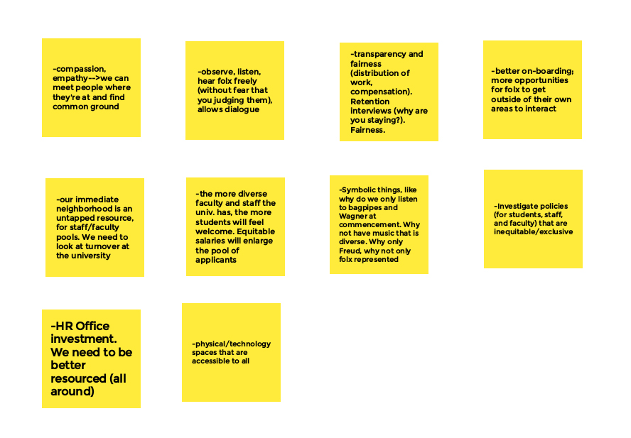

Slide 21
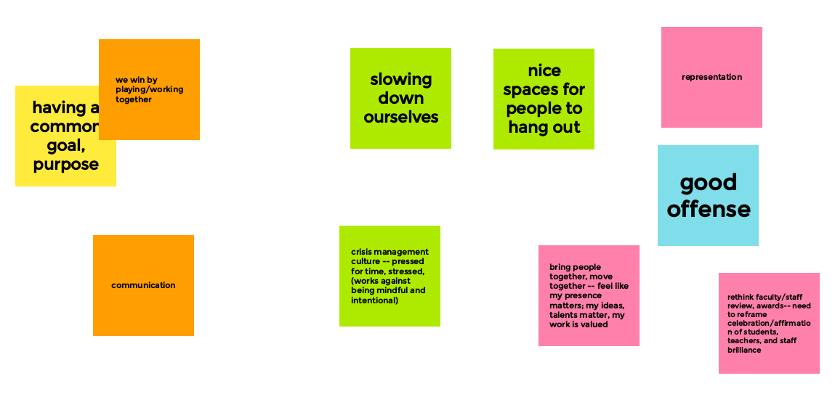

Slide 22
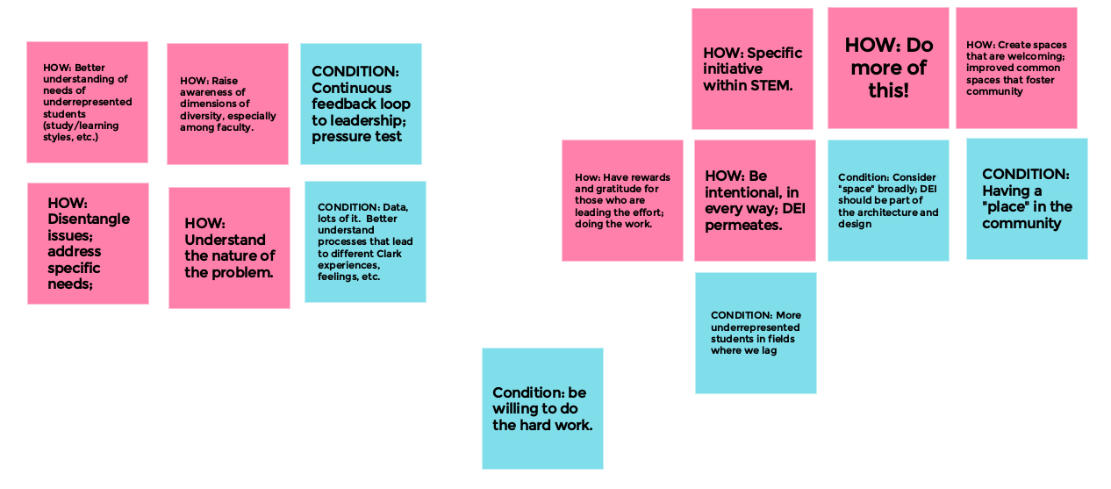

Slide 23
